Slide 1

NOTES: Animal Cell Organelles
.
Goal:
Questions: Notes:
Personal Reflection:
010
011

Slide 2

Table of Contents: Be sure to match your table of contents so that we all work together as a class.
Pg. | Left Side Items |  | Pg. | Right Side Items
000 | SA: Mother Earth |  | 001 | NOTES: Characteristics of Life
002 | LAB: Evaluating Microscopes |  | 003 | LAB: Microscope of Letter “e”
004 | SA: Multiple Origins of Life |  | 005 | Levels of Organization
006 | Viral Reproduction Mechanisms |  | 007 | VN: Virus Life & Evolution
008 | SA: RNA World |  | 009 | NOTES: Plant Organelles
010 | NOTES: Animal Organelles

Slide 3

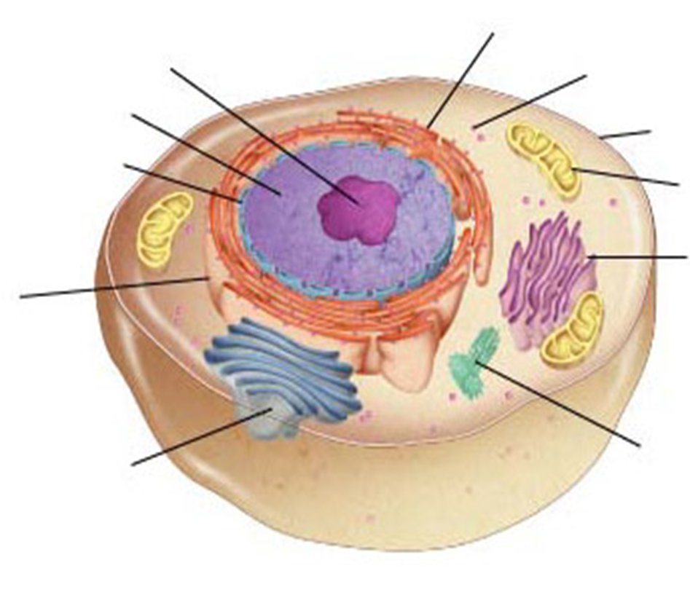
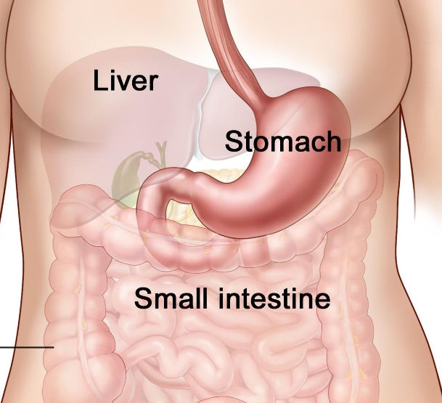
Week 03 Thursday Goal: By the end of the lesson, students will be able to … identify the structure and function of all animal organelles.
Background:
Liver cells have more smooth endoplasmic reticula than nerve cells. Muscle cells have more mitochondria than skin cells. Stomach cells have more lysosomes & rough endoplasmic reticula than heart cells.
Starter Question:
Why do you think there is so much variation in the abundance of organelles in each of these tissues or organs?

Slide 4
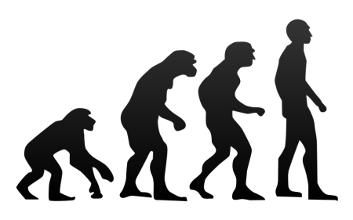
Right Side Notes
In the 4.5 billion year history of Earth, we have discovered patterns often provide evidence for evolutionary change.
.
.
1F. What is the evidence for change?
2F. What are some of the pattern of change?
3C. Is there evidence that all life follows a similar pattern?
4D. Is change necessary?
90
91

Slide 5
Evidence That You Have Successfully Completed This Lesson
Checkpoints
Identify each animal cell organelle by function for its Friday’s exam.
Identify each animal cell organelle by structure for Friday’s exam.
Independently complete your personal reflection and notebook big idea page.

Slide 6

Cell Overview Cell Structures
Ribosome
(attached)
Lysosome
Nucleolus
Ribosome
(free)
Nucleus
Cell
Membrane
Nuclear
envelope
Mitochondrion
Rough
endoplasmic
reticulum
Smooth
endoplasmic
reticulum
Centrioles
Golgi apparatus
Cytoplasm
& Cytoskeleton

Slide 7
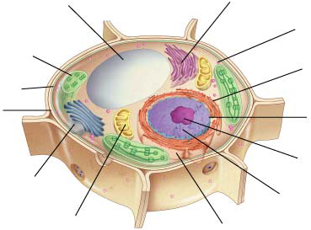
Cell Overview Cell Structures
Vacuole
Smooth endoplasmic
reticulum
Ribosome
(free)
Chloroplast
Ribosome
(attached)
Cell
Membrane
Nuclear
envelope
Cell wall
Nucleolus
Golgi apparatus
Nucleus
Mitochondrion
Rough endoplasmic reticulum

Slide 8
Animal Cell: Golgi Apparatus
FUNCTION
Modifies, sorts, and packages proteins and other materials from the ER
Storage or secretion of proteins outside the cell
Finishing touches for proteins.
Golgi Apparatus
STRUCTURE
Like a customization shop
Series of closely apposed membranes

Slide 9
Animal Cell: Cytoskeleton
FUNCTION
Support structure and transportation system
Maintain cell’s shape
Important in cellular division as microtubules form mitotic spindle
Cytoskeleton
STRUCTURE
Microtubules
Network of protein filaments (actin)
Tough, flexible framework

Slide 10
Animal Cell: Lysosomes
Lysosomes
FUNCTION
Digestion of lipids, carbohydrates, and proteins into small molecules for the cell
Break down organelles that have outlived usefulness.
STRUCTURE
Cleanup crew
Organelles filled with enzymes

Slide 11
Animal Cell: Cell Membrane
Cell Membrane
FUNCTION
Regulates what enters and leaves the cell
Provides protection and support
Proteins form channels and pumps to move materials across this
Carbohydrates identify particles.
STRUCTURE
Made of a double-layered sheet
Lipid bilayer
Flexible structure
Barrier between the cell and its surroundings
Mosaic of molecules on the surface

Slide 12
Understanding ✓ #1
What would happen to a cell if any of its organelles stopped functioning properly?
Could other organelles compensate for a type of deficient organelle?
The cell would not function properly or would die.
Because organelles are so specialized, no other organelle can replace the defective one.

Slide 13
Animal Cell: Centrioles
FUNCTION
Helps organize cell division.
Present only in animal cells.
Centrioles
STRUCTURE
Microtubule structures
Formed of tubulin
Located near the nucleus

Slide 14
Animal Cell: Mitochondrion
FUNCTION
Provides energy for the cell
Convert the chemical energy of food into compounds for cell
Regulates respiration (not breathing).
Mitochondrion
STRUCTURE
Present in plant and animal cells
Enclosed by two membranes
Outer
Inner
Inherited maternally

Slide 15
Animal Cell: Cytoplasm
FUNCTION
Provides space for cell functions to occur.
Cytoplasm
STRUCTURE
Portion of the cell outside the nucleus
Liquid part of the cell
Contains all the organelles
Occupies more than half of the internal volume of the cell

Slide 16
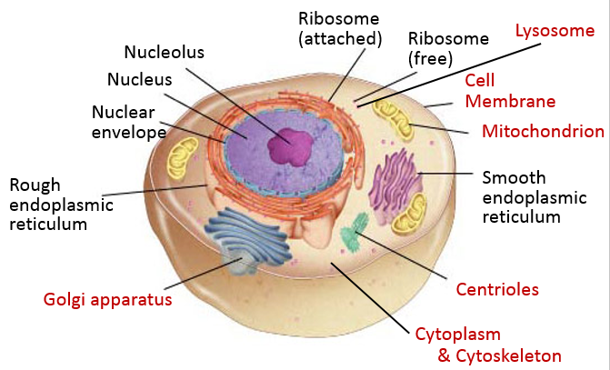
Checkpoint 1
Identify each animal cell organelle by function for its Friday’s exam.

Slide 17
Checkpoint 2 Animal Structures
Ribosome
(attached)
Lysosome
Nucleolus
Ribosome
(free)
Nucleus
Cell
Membrane
Nuclear
envelope
Mitochondrion
Rough
endoplasmic
reticulum
Smooth
endoplasmic
reticulum
Centrioles
Golgi apparatus
Cytoplasm
& Cytoskeleton

Slide 18
Checkpoint 2 Plant Cell Structures
Vacuole
Smooth endoplasmic
reticulum
Ribosome
(free)
Chloroplast
Ribosome
(attached)
Cell
Membrane
Nuclear
envelope
Cell wall
Nucleolus
Golgi apparatus
Nucleus
Mitochondrion
Rough endoplasmic reticulum

Slide 19
Check
point 2
Identify each animal cell organelle by structure for Friday’s exam.

Slide 20
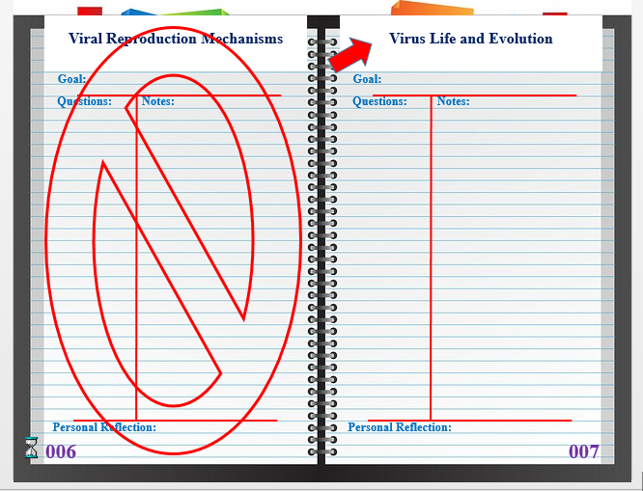
Checkpoint 3 Interactive Notebook
Good Job!
Independently complete your personal reflection and notebook big idea page.

Slide 21

Evidence That You Have Successfully Completed This Lesson
Checkpoints
Good Job!
Identify each animal cell organelle by function for its Friday’s exam.
Identify each animal cell organelle by structure for Friday’s exam.
Independently complete your personal reflection and notebook big idea page.

Slide 22
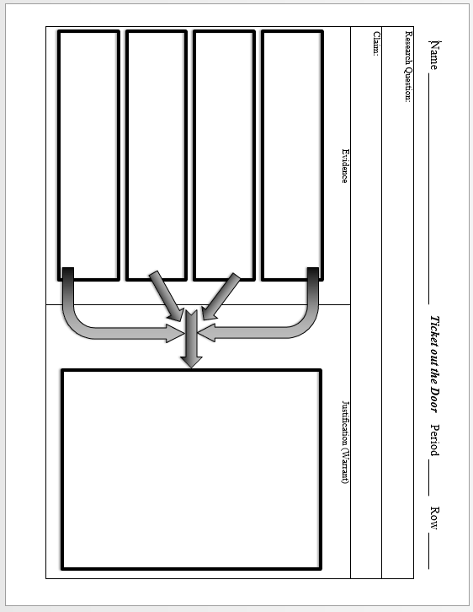
Conditions for Success
Claim: Some people relate a cell to a factory. Using either the plant or animal cell as a model, explain how any four of its organelles resembles the roles of jobs in a factory.
Due Friday
Complete the following ticket out the door as a formative assessment.

Slide 23
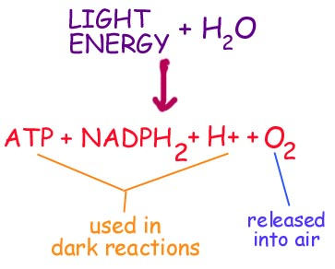
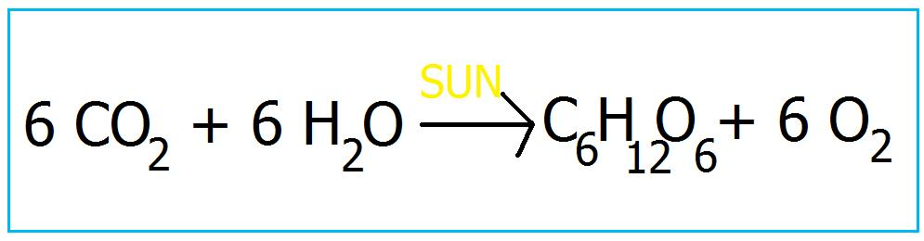
Mitochondria
Due
Today
Time Check

